Slide 1
BI Automation
FILE / DATA Comparison TOOL
Nov 2022

Slide 2
AGENDA
AUTOMATION FRAMEWORK
1
USE CASES
2
FEATURE LIST
3
HIGH LEVEL DESIGN / APPROACH
4
OUTPUT SCREENSHOTS
5
DEMO
6
TIMELINE / MILESTONE PLAN

Slide 3
USE CASEs
AUTOMATION FRAMEWORK
OBJECTIVE | To compare the file/data and certify the deployment in a semi automated way
APPROACH | Manually copy the required files(both old & new versions) in the configured folder paths and run the framework
OUTPUTS | Framework will compare the results cell by cell and will capture the results in both html & excel files
USE CASES
Migration check: File generated in the new system against the file from the legacy system
Version check: Comparing the file generated pre and post deployment(Version diff check)
Env 1
Env 2
f1
f1
Env 1
v1
v2

Slide 4




FEATURE LIST
AUTOMATION FRAMEWORK
Core features
File to File comparison (with primary key/full scan)
Table to table comparison
Key Integrations
Testrail – Test case management & Email notification
AWS S3 – For reading files or to store the results
Tech stack
Python – Pandas, Pytest
File to Table comparison
Table to File comparison
STAG validations(Query)
AWS CLI, S3
<<Package/deployment>>
DB : Mysql/Redshift
File formats: csv/xlsx
Jira/Jenkins integration

Slide 5
High level design / Approach PROPOSED
AUTOMATION FRAMEWORK
Manual execution
CREDO NON-PROD (T1)
LEGACY NON-PROD (On-Prem)
Generate csv /xlsx files/Table outputs
Test Rail
Python framework
Story
Create test cases
Read the configs
File storage
Local folder
Run relevant test cases
Execute the test cases(file to file/table to table etc)
Generate csv /xlsx files/Table outputs
Test rail integrated execution
S3 location
Push/Pull to Test Env
Update results back & Email alerts
Update results back
Data Lake
Data Lake

Slide 6
High level design / Approach PROPOSED
AUTOMATION FRAMEWORK
Steps:
Qlik report objects needs to be extracted as csv/xlsx output manually from both the legacy BDP & CREDO Qlik Test environments
These files needs to be transferred to the CREDO T1 environment (S3 copy) manually and then to the local folders accordingly
File compare Framework will reside in the CREDO T1 environment which further can compare the files copied in the S3 location / local folder
The output will get generated in .xls & .html format which will be available in the CREDO T1 environment, wherever the application is running or can copy the results to S3 back.

Slide 7
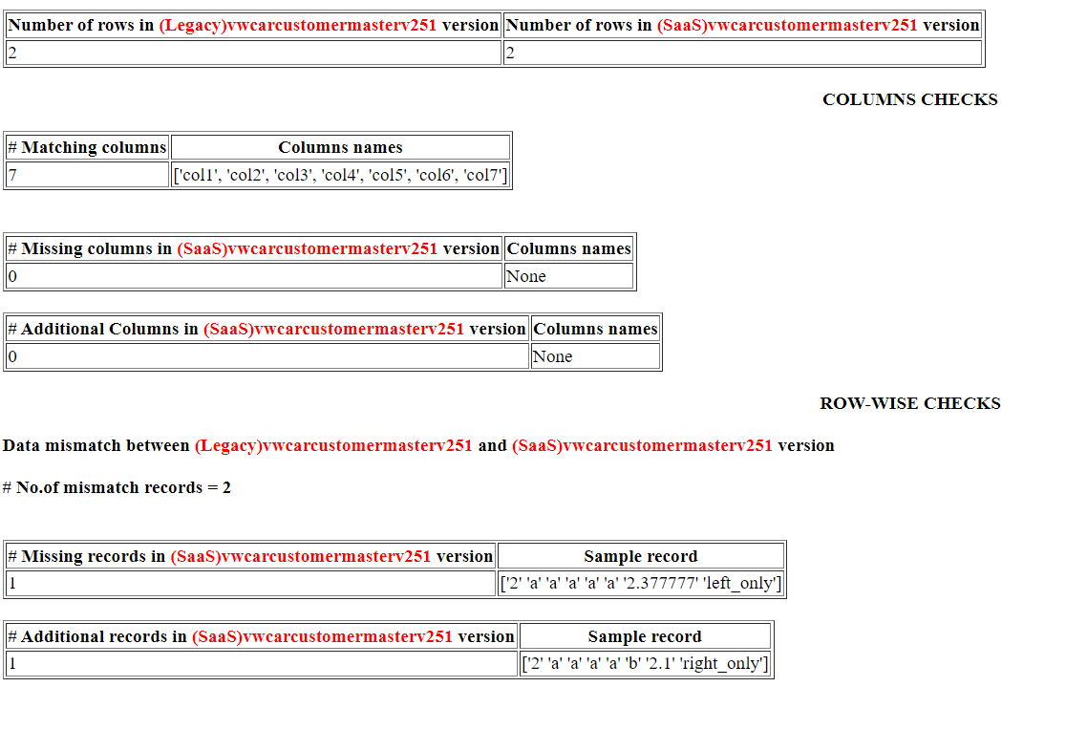
OUTPUT SCREENSHOTS
AUTOMATION FRAMEWORK
 | First |  |  |  |  |  |  |  | Second
 | col1 | col2 | col3 | col4 | col5 | col6 | col7 | _merge | col1 | col2 | col3 | col4 | col5 | col6 | col7 | _merge
0 | 1 | a | a | a | a | a | 1.1111 | both | 1 | a | a | a | a | a | 1.1111 | both
1 | 2 | a | a | a | a | a | 2.377777 | left_only | 2 | a | a | a | a | b | 2.1 | right_only

Slide 8
AUTOMATION DEMO

Slide 10
CAEMLOT BI Implementation
AUTOMATION FRAMEWORK
W1
W2
W3
W4
W5
W6
W7
W8
W9
W10
W11
W12
Phase 1 – File checks
Phase 2 – File & Table checks & adding regression suites
Phase 3 – 3rd Party integrations (Testrail, Jira etc…)

